Slide 1


Tools of the Trade
Essential Development Environment for Machine Learning

Slide 2
Agenda
Python Libraries & Frameworks
AI Coding Assistants
NumPy, Pandas, TensorFlow, PyTorch
GitHub Copilot, Gemini, CodeWhisperer
Development Environments
Setting Up Your Workflow
Jupyter, VS Code, Cloud Platforms
Integration, Best Practices
Version Control & Collaboration
Git, GitHub, Hugging Face

Slide 3



Libraries vs Frameworks
Both libraries and frameworks are tools that help developers build ML applications more efficiently, but they serve different purposes.
Libraries
Frameworks
Collections of pre-written code
Comprehensive development structures
You call the library code
Framework calls your code
Focused functionality
End-to-end solutions
Greater flexibility
Standardized approach

Slide 4

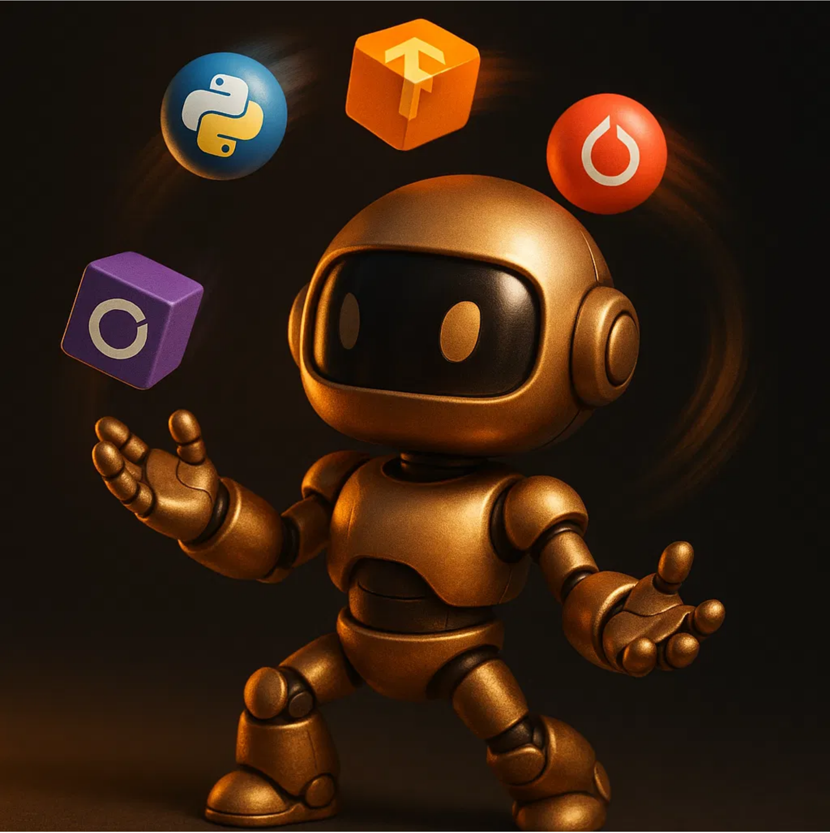




Essential ML Libraries
Collections of functions and methods that allow you to perform specific tasks without writing code from scratch.
NumPy
Fundamental package for scientific computing with Python. Provides support for arrays, matrices, and mathematical functions.
Pandas
Data manipulation and analysis library. Offers data structures and operations for manipulating numerical tables and time series.
Scikit-learn
Machine learning library featuring various classification, regression, and clustering algorithms. Built on NumPy, SciPy, and matplotlib.
Matplotlib/Seaborn
Visualization libraries for creating static, animated, and interactive visualizations in Python.

Slide 5

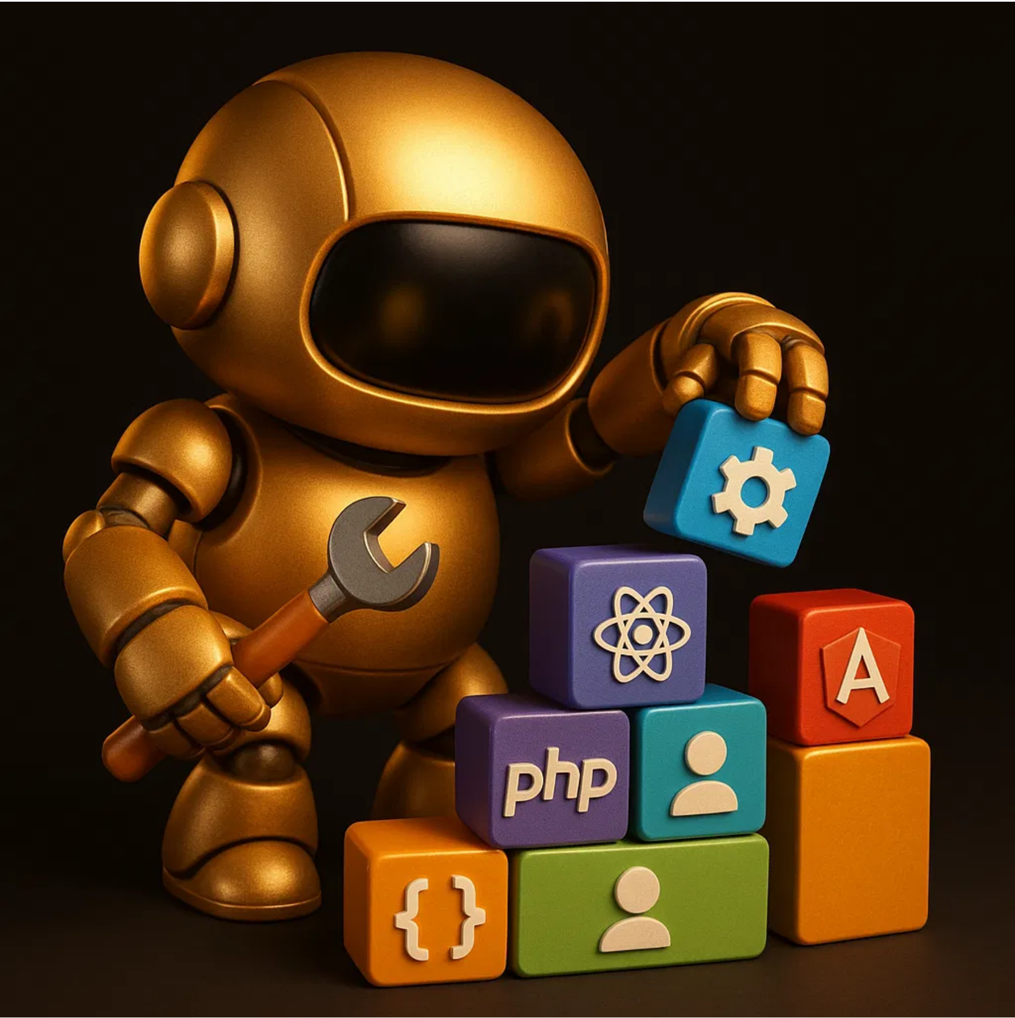




Popular ML Frameworks
Collections of pre-built tools, libraries, and APIs that help developers create machine learning models and applications more efficiently.
TensorFlow
Google's open-source platform for machine learning with production-ready deployment capabilities.
PyTorch
Facebook's deep learning framework known for its flexibility, dynamic computation graph, and research focus.
Keras
High-level neural networks API that runs on top of TensorFlow, designed for rapid prototyping.
Fastai
Simplifies training neural nets using modern best practices, built on PyTorch.

Slide 6










Jupyter Notebooks & JupyterLab
Interactive development environments that combine code execution, rich text, mathematics, plots and rich media in a single document.
Jupyter Notebooks
JupyterLab
Interactive code cells with immediate execution
Flexible interface with tabs and panels
Markdown support for documentation
Integrated terminal access
Full text editor with syntax highlighting
Inline visualization of results
Easy sharing and collaboration
File browser and multiple document views
Perfect for data exploration, prototyping, and creating reproducible research.

Slide 7












Google Colab
Google Colaboratory (Colab) is Google's free cloud-based version of Jupyter notebooks, designed specifically for machine learning and data science.
What is Google Colab?
Think of it as "Jupyter notebooks in the cloud" - you get all the power of Jupyter but running on Google's servers with free GPU access!
Traditional Jupyter
Google Colab
Runs on your computer
Runs in the cloud
Requires installation
Just open in browser
Limited by your hardware
Free GPU/TPU access
Files stored locally
Auto-saves to Google Drive
Manual package management
Pre-installed ML libraries
Perfect for beginners - no setup required, just start coding!

Slide 8




Cloud Development Environments
Cloud-based platforms provide ready-to-use environments for ML development without local setup or hardware constraints - perfect for students with limited computing resources.
In This Course We'll Use:
Google Colab and AWS SageMaker Studio Lab - both are FREE and designed specifically for students and learning!
Google Colab (Primary)
Free Jupyter notebook environment with GPU/TPU access, pre-installed ML libraries, and seamless Google Drive integration. No installation required - just open in your browser!
✓ 12+ hours of free GPU time ✓ Built-in Gemini AI assistant ✓ Easy sharing and collaboration
AWS SageMaker Studio Lab (Secondary)
Amazon's free ML development environment with persistent storage, pre-configured environments, and professional-grade tools. More powerful than Colab for larger projects.
✓ 15GB persistent storage ✓ More compute time ✓ Professional ML tools ✓ No credit card required

Slide 9


Local Development: VS Code
For students who want to work on their own computers, we'll use VS Code - a free, powerful code editor.
What's an IDE?
IDE = Integrated Development Environment. Think of it as Microsoft Word, but for writing code instead of documents!
HCC Lab Computers:
VS Code is already installed! You may need to add Python and Jupyter extensions.
1
Install Python
Download from python.org (NOT Anaconda - we'll explain why later)
2
Install VS Code
Free download from code.visualstudio.com
3
Add Extensions
Python extension + Jupyter extension (we'll show you how)
4
Start Coding!
Create your first Python file and run it

Slide 10


AI Coding Assistants
AI tools that help you write code faster and with fewer errors. Think of them as smart autocomplete that understands programming!
1. Traditional LLMs with Coding
General AI assistants that can help with code through chat interfaces
Examples: ChatGPT, Claude, Gemini - Great for learning and explaining code
2. Cloud Environment Assistants
Built into cloud platforms, integrated with your notebooks
Examples: Gemini in Colab, CodeWhisperer in SageMaker - We'll use these!
3. IDE-Integrated Tools
Built into code editors, suggest code as you type
Examples: GitHub Copilot in VS Code, Cursor AI editor - For advanced users
In This Course:
We'll start with cloud-based assistants (Gemini in Colab) and traditional LLMs for learning. As you advance, you can explore IDE tools like Copilot and Cursor.

Slide 11

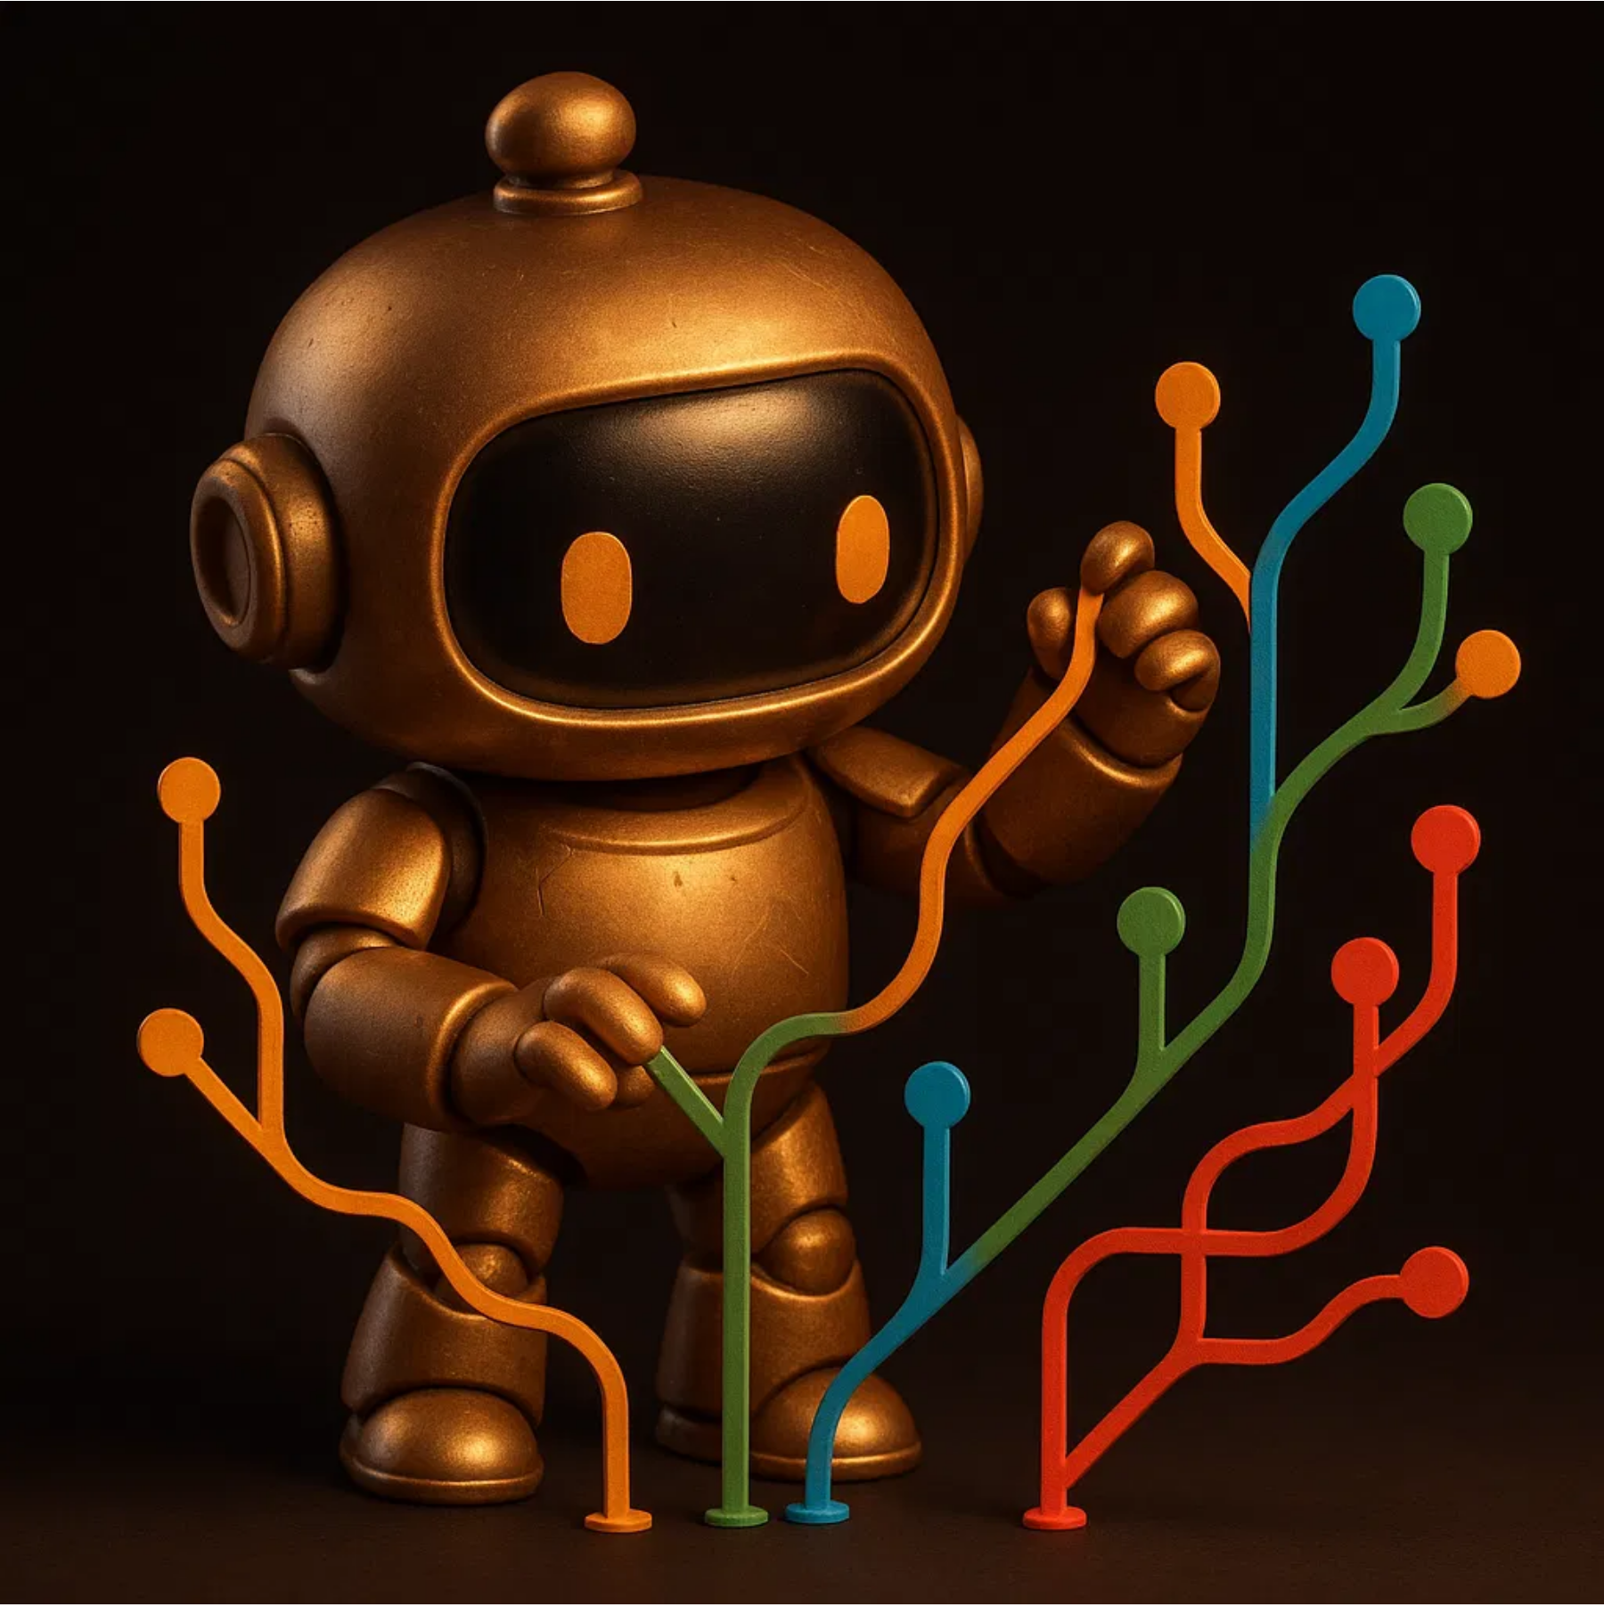













Git & GitHub
Git is a distributed version control system, while GitHub is a cloud-based hosting service for Git repositories that adds collaboration features.
Basic Git Workflow
Edit Files
Stage Changes
Commit
Push
Branching & merging for parallel development
Pull requests for code review
Issue tracking for bugs and features
Project boards for task management
GitHub for ML Projects
Model Version Control
Dataset Management
Experiment Tracking

Slide 12









Hugging Face Hub
Hugging Face Hub is a platform for sharing and collaborating on machine learning models, datasets, and demos, with a focus on natural language processing and computer vision.
Models
Datasets
Spaces
Pre-trained models ready for fine-tuning and inference across various tasks
Curated datasets for training and evaluating machine learning models
Interactive demos and applications to showcase ML projects
Transformers Library
A Python library providing thousands of pre-trained models for various ML tasks with a unified API.
Text Classification
Translation
Image Classification
Speech Recognition
Community-Driven Platform
100K+
20K+
150K+
Models
Datasets
Developers

Slide 13


Setting Up Your ML Development Workflow
A step-by-step approach to creating an effective ML development environment from scratch.
Our Course Strategy:
Start with cloud environments (no setup needed), then learn local development for advanced projects.
Start with Cloud (Week 1-4)
1
Google Colab and AWS SageMaker Studio Lab - no installation required
Perfect for learning basics without technical setup barriers
Install Python Locally (Week 5+)
2
Standard Python from python.org + virtual environments
Professional approach used in industry
Set Up VS Code
3
Install Python and Jupyter extensions for local development
Industry-standard IDE with AI coding assistants
Add Version Control
4
Git and GitHub for project management and collaboration
Essential for any professional development work

Slide 14





Why Not Anaconda for AI Professionals?
While Anaconda is popular for beginners, AI professionals prefer more precise control over their development environment.
Issues with Anaconda:
Bloated:
Installs 250+ packages you may never use, taking up 3+ GB of space
Licensing Issues:
Commercial use now requires paid licenses (2024 changes)
Dependency Conflicts:
Can create version conflicts with system Python and other tools
Slower Updates:
Often lags behind latest package versions needed for cutting-edge AI
Professional Approach:
Use standard Python + virtual environments (venv) + pip for precise control over dependencies
✓ Lightweight ✓ Current packages ✓ No licensing issues ✓ Industry standard

